Slide 1
PCD Tracker
Storyboard
Gene Belford
9 May 2017
Notes:
Description
Enter description here
Requirements
R1
R2
R3
Functions
F1
Business Rules
BR1
BR2
BR3
Data Objects
DO1
DO1
DO1
Complexity 0
Inputs 0
Outputs 0
Inquires 0
Files/Tables 0
Ext. Files 0

Slide 2

PCD Tasker Search Parameters
Man PR and Clw PR were program defined fields?
Where do keywords get entered?
And/Or?
RecID
Keyword(s)
PCD
TBD
Contract
N00024-15-C-6222
Mod
SLIN
Funded
Y
FEA
PN
Dwg
BOM
Man PR
Clw PR
N
Customer RDD
1/1/17
to
12/31/19
PCD Required
to
Internal RDD
to
Next Review
to
Program Defined Fields:
Hull
794
Add
TI
16
Delete
Select
Select/Enter…
Distinct list from all Projects for DDLB?
Use value from column 1 to filter for select values?
Search
Clear Search
Task View

Slide 3
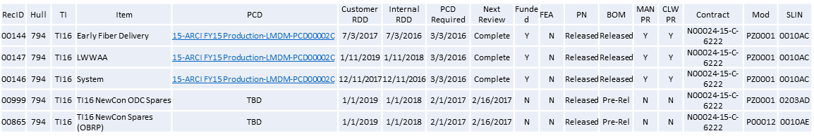

PCD Tasker Search Results
Suggest splitting into a status and next review fields
Would this be restricted to only PCD tasks or all tacks?
Edit Search
Select
Task View

Slide 4
PCD Tasker Data Review
RecID
00999
Subject:*
VA Class (New Con) Delta Spares
PCD
TBD
Contract:*
N00024-15-C-6222
Mod
SLIN
$ Est
Funded
N
P00012
0203AD
$300K
FEA
PN
Dwg
BOM
Next Review
N
Released
Released
Pre-Rel
3/2/17
Customer RDD
1/1/19
Internal RDD
2/1/18
PCD Required
2/1/17
Originator:
Joe Smith
Status:
In-Progress
Required: *
Task
Identifier
Name/Description
Pending
Attachment(s)
BOM
Originator
Reviewer
Approver
Mullins, Jeremiyah
Myers, Janet (Pending)
Smith, Joe (Pending)
Jones, William (Approved)
Identifier
Name/Description
Status
Attachment(s)
BOM
Originator
Reviewer
Approver
Task Maintenance
Program Defined Fields:
Notes:
Hull
794
Add
TI
16
Delete
Select
Select/Enter…
Add Tracker
Copy Existing Tracker
Edit
Save
Delete
Draft PCD
Task View

Slide 5
PCD Task Maintenance
RecID
00999
Subject
VA Class (New Con) Delta Spares
Contract
N00024-15-C-6222
Task
Role1
Role2
Role3
Identifier
Name/Description
Status
Attachment…
Purch Req
Originator
Reviewer
Approver
Mullins, Jeremiyah
Myers, Janet (Pending)
Smith, Joe (Pending)
Jones, William (Approved)
Identifier
Name/Description
Status
LVA 790 Additional ABF Delta_HW …
BOM
Originator
Reviewer
Approver
Name(s)
Name(s) Status
Name(s) Status
Identifier
Name/Description
Status
LVA 790 Additional ABF Delta_HW …
Required: *
References to hold PR, etc?
Identifier
Name/Description *
Status *
Required By:
2/1/17 *
Task Type *
Originator *
Name
Reviewer
Name(s)
Approver *
Name(s)
Task comments?
Add
Delete
Add
Delete
Add
Delete
Directory Helper
Directory Helper
Approver Helper
Attachments:
LVA 790 Additional ABF Delta_HW List_790_v02.xls
Attach
Add Task
Copy
Edit
Save
Delete
Task View
Notes:
Description
The HMI will allow the authorized user to add, update, delete, and close tasks. The HMI will contain a scrolled section that displays tasks already entered for the associated tracker. When the user
Requirements
The system shall automatically assign item identifiers that are unique.
The system shall validate that all required fields are complete.
The system shall allow the <authorized user> to maintain the enumerations used in the drop-down list boxes.
The system shall use the <active directory> to assign individual tasks.
Business Rules
The <Required By> date cannot be later than or the same as the <Internal RDD> date.
Functions
Action Person Helper
Approver Person Helper
Enumeration Helper
Attachments
Notes?
Data Objects
Trackers
Tasks
Users
Enumeration Values
Notes
Attachments
Complexity

Slide 6
PCD Tracker Entry
Change this to a count and the lowest status of the BOMs
(non-editable)
RecID:
00999
Subject:*
Enter Subject...
PCD:
TBD
Contract:*
Select Contract…
Mod
SLIN
$ Est
Funded:
N
Enter…
Enter…
$0
FEA:
PN
Dwg
BOM
Next Review:
NA
Select…
Select…
Select…
3/2/17
Customer RDD:
1/1/19
Internal RDD:
2/1/18
PCD Required:
2/1/17
Originator:
Joe Smith
Status:
In-Progress
Required: *
Task
Metadata?
Pre-defined lead times?
Overall status of the PCD?
Task Maintenance
Program Defined Fields:
Notes:
Add
More details?
(date and author on each note)
Hull
794
TI
16
Delete
Select
Select/Enter…
Can a note be edited?
Add Task
Copy Existing Tasker
Edit
Save
Delete
Draft PCD
Task View
Notes:
Description
From this HMI the user will enter common information needed by, or status information for a related set of tasks. When the user clicks on the ‘Add Task’ button the system will switch to the <task Maintenance> page. (Can the ‘Add Task’ be merged into ‘Task Maintenance’.) When the user clicks on the ‘Copy Existing Tasker’ a new tasker will be created. (Do the tasks when copy also, or is that a option that should be proved?)
Sort/filter?
Requirements
The system will all the <users> to add, update and remove <tasks>.
The system will allow the <users> to copy an existing <tasker> into a new <tasker>.
The system will allow the <users> to generate a <draft PCD> from the related <tasks>.
The system will show the lowest status of a reportable item.
The system will allow the <user> to all the tasks the have been assigned to the <tracker>.
The system will allow only <authorized users> to edit and/or delete a <tracker>.
Business Rules
Required dates can be no early than the current date.
The <PCD Required> date cannot be later than or the same as the <Internal RDD> date.
The <Internal RDD> date cannot be later than or the same as the <Customer RDD> date.
The <PCD> identifier will default to ‘TBD’ upon <tracker> creation.
The <PCD> identifier will be updated with <draft PCD> identifier upon generation.
The <draft PCD> will have the identifier of the individual who clicked the button assigned as the <originator>.
The <PCD> identifier will be updated with <PCD> identifier upon approval.
The <contract> identifier will default to <blank>.
The <mod> identifier will default to <blank> until selected by the <project manager>.
The <slin> identifier will default to <blank> until entered by the <project manager>.
The <$est> will default to <blank> until entered by the <project manager>.
The <funded> will default to ‘N’ until selected by the <project manager>.
The <fea> identifier will default to ‘NA’ until selected by the <project manager>.
The <pn> identifier will default to <blank> until selected by the <project manager>. Enumeration Type: Approval (blank, Pre-Release, Released)
The <dwg> identifier will default to <blank> until selected by the <project manager>. Enumeration Type: Approval (blank, Pre-Release, Released)
The <bom> identifier will default to <blank> until selected by the <project manager>. Enumeration Type: Approval (blank, Pre-Release, Released)
The <customer rdd> identifier will default to <blank> until entered by the <project manager>.
The <internal rdd> identifier will default to <blank> until entered by the <project manager>.
The <pcd required> identifier will default to “<internal rdd> less the <pre-defined lead time>”.
Enumeration Type: Task Type (blank, PN, DWG, DOM, PCD, PR)
Functions
Contract Selector
Enumeration Helper
Data Objects
Trackers
Contracts
Notes
Complexity

Slide 7
PCD Hardware List Entry
Would this be better with the part, or parts group?
RecID:
Draft-ER-00999
Current Status:
Pending
Department:
M7F5
Subject:
Hardware List
Classification:
Unrestricted
Additional Columns?
Purchase Order
MAN/CLW
Contract CLIN
Contract:
N000##-##-X-1002
N000##-##-X-1003
Purchasing Contacts:*
Name
Add
Delete
Required: *
Directory Helper
Part
Number*
Mfg Part
Number
Nomenclature*
Qty*
Unit
Cost*
Cost
Total
Work
Package*
RDD*
N139894-1 Sonar Laptop 2 $800
$1600
$1600 Total
1M17ESL1N223 Hdw
1M17ESLLC223 Labor
Add
Delete
Reset
Save
Cancel
Attachments:
Attach
View
Group By?
Purchasing
Work Package
Whatever
Comments:
04/18/2017 - LM Production is directed/authorized to generate for the Technology Part Task Trainer hardware listed below. LM Production shall notify Bill Steinbach (1511) once the kits are available for delivery.
Note: All material in the Sonar Lap top kits are required except for the Lap Tops P/N N146823-1 Item 25 on the N139894-1 BOM. We already have the Laptops (N146823-1) for the kits but need two sets of the remaining items.
Approve
Rework
Cancel
Task View

Slide 8
PCD Task View
PCD Task List
User:
Joe Smith
Show
10
entries
Role
Task
Action
Contract
Subject
Due Date
Originator
BOM
Create
N00024-15-C-6222
VA Class (New Con) Delta Spares
1/15/17
Reviewer
PCD
Review
…
…
…
Reviewer
…
Review
…
…
…
Reviewer
…
Review
…
…
…
Approver
PR
Approve
…
…
…
Approver
ER
Create
…
…
…
Go To
Add Tasker
Search
Admin
Close
Notes:
Description
Upon user initial connection, the system will display a list of tasks/actions, in descending ‘due date’ order, that the user is responsible for.
Requirements
The system will allow the <users> to sort upon any of the data columns.
The system will allow the <users> to select a <task> to open.
The system shall allow <authorized users> with the <appropriate rights> to add new tasking.
The system shall allow <authorized users> with the <appropriate rights> to access administrative functions
Search
The system shall highlight <tasks> due with X number of days.
Functions
Business Rules
X
Y
Z
Data Objects
Users
Tasks
Complexity 7
Inputs 3
Outputs 1
Inquires 1
Files/Tables 2
Ext. Files 0

Slide 9
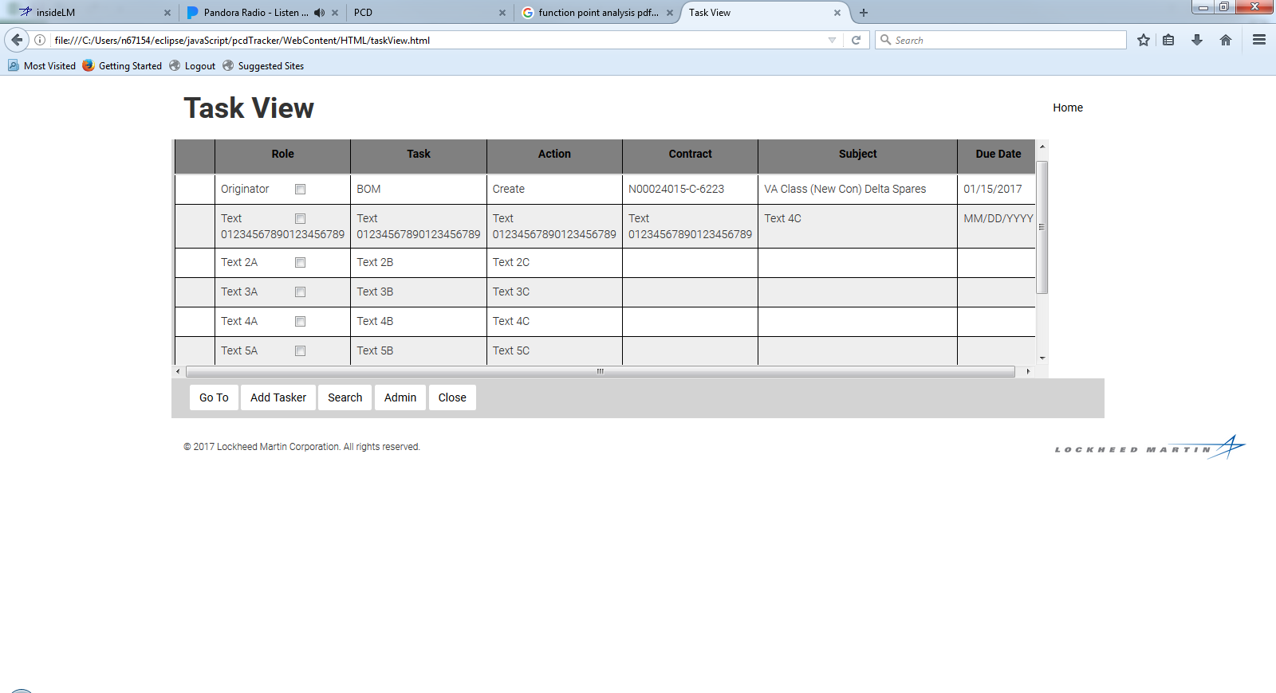
PCD Task View HTML Mockup
\\mvnf02\TEAMSUB\Program Tracking Tool Development\pcdTracker\WebContent\index.html

Slide 10
PCD BOM Entry
RecID:
Draft-BOM-00999
Current Status:
Pending
Department:
M7F5
Item:
Bill of Materials
Version:
2.1
Classification:
Unrestricted
Contract:
N000##-##-X-1002
N000##-##-X-1003
Source:*
Enter Here..
Required: *
Approvers:
Smith, Joe
Date Approved:
YYYY-MM-DD
BOM Id*
Description
Status*
Comments
BOM-00877 Sonar Laptop Pre-Release Ready for review MM/DD
BOM-00101 Wiring Interface Kit Released
Add
Delete
Reset
Save
Cancel
Attachments:
LVA 790 ABF Eng Dwg_790_v02.jpg
Attach
View
Comments:
04/18/2017 -
Approve
Rework
Cancel
Task View

Slide 11
PCD BOM Entry
RecID:
Draft-BOM-00999
Current Status:
Pending
Department:
M7F5
Item:
Bill of Materials
Version:
2.1
Classification:
Unrestricted
Contract:
N000##-##-X-1002
N000##-##-X-1003
Source:*
Enter Here..
Additional Columns?
Remarks
Required: *
Approvers:
Smith, Joe
Date Approved:
YYYY-MM-DD
Level*
Part
Number*
Item Description*
Group
Unit of
Measure
Qty
Req’d*
1 N139894-1 Sonar Laptop 2 Each 2
1 BOM-00101 Wiring Interface Kit 2 Kit 2
Add
Delete
Reset
Save
Cancel
Attachments:
LVA 790 ABF Eng Dwg_790_v02.jpg
Attach
View
Comments:
04/18/2017 -
Approve
Rework
Cancel
Task View

Slide 12
Current PCD Entry Screen
* = Required Field New PCD
PCD: Draft-001316 Date: 4/26/2017
Current Status: New Revision: New
Department*: Originator: Belford, Eugene
Subject*: Due Date: Calendar
Classification*: Third Party Proprietary Information:
Organizational Conflict of Interest (OCI):
Contract(s) / Purchase Order(s)*:
Approver(s)*:
(A) = Approved; (R) = Rework; (P) = Pending; (X) = No Action Required
Action Responsible Person(s):
Program(s)*: Program Recipient(s):
(Automatically filled based on program(s) selected)
Program to use in PCD number*:
Additional Recipient(s):
Work Package:
Action / Comments*:
Reference:
Attachments:
Add
Delete
Add
Delete
Add
Delete
Add
View
Delete
Add
Delete
Add
View
Delete
Save
View
Cancel
Task View

Slide 13
PCD Task Review/Approve Status
RecID:
Draft-ER-00999
Current Status:
Pending
Department:
M7F5
Task:
PCD / PR / BOM
Originator:
Smith, Joe
Subject:
Sample ER for Approval
Classification:
Unrestricted
Contract:
N000##-##-X-1002
N000##-##-X-1003
Additional elements to be determined
Attachments:
Sample_ER_File.xlsx
Sample_ER_for_Project.docu
View
Rework
Comments:
Add notes here.
Approve
Rework
Cancel
Task View

Slide 14
Approve PCD
* = Required Field New PCD
PCD: Draft-001316
Current Status:
Department: M7F5
Subject: Sample PCD for Approval
Classification:
Unrestricted Unrestricted
Contract(s) / Purchase Order(s)*:
N00024-15-C-6222 (FY17 T116 Production)
Approver(s)*:
(A) = Approved; (R) = Rework; (P) = Pending; (X) = No Action Required
Eubank, Joey (P)
Action Responsible Person(s):
Program Recipient(s):
Baldwin, Kathleen
…
Program(s)*:
ARCI FY17 TI16 Production
Program to use in PCD number*:
ARCI FY17 TI16 Production
Additional Recipient(s):
Work Package:
Labor work package 1Mxxxxxxxxxxxxxx Material work package 1Mxxxxxxxxxxxxxx
Action / Comments*:
4/27/2017 - xxxxxxxxxxxxxxxxxxxxxxxxxxxxxxxxxxxxxxxxxxxxxxxxxxxxxxxxxxxxxxxxxxxxxx
Reference:
Rework Comments:
Attachments:
There are no attachments associated with this PCD.
Approve
Rework
Cancel
Closure
Close PCD

Slide 15
PCD Admin Function
Contract
Program
Need to see what already exists
Users
Add Contract
Add Program
Add User
Delete
Archive
Task View

Slide 16
PCD Tracker Functions
DO1

Slide 17
Enumeration Helper
Assign Enumeration
Select an enumeration
Approval Status
A: Approved
R: Rework
P: Pending
X: No action required
OK
Cancel
Notes:
Description
Allows the user to select a value to populate a selection box. This could be either a separate popup, or a drop down list box depending on the standards used.
Requirements
R1
R2
R3
Functions
F1
Business Rules
The code value is distinct.
The code name is distinct.
The list will only contain valid/<active> codes.
Codes that are inactive will this be displayable for historical data.
Selection/validation of enumeration values will use the <enumeration code> and <enumeration value code>.
Data Objects
Enumeration Types
Enumeration Values
Complexity

Slide 18
Enumeration Types

Slide 19
Enumeration Values

Slide 20
Enumeration Associated Values

Slide 21
PCD Admin

Slide 22
Contract Entry

Slide 23
Contract Program

Slide 24
User Entry

Slide 25
PCD Functions
DO1

Slide 26
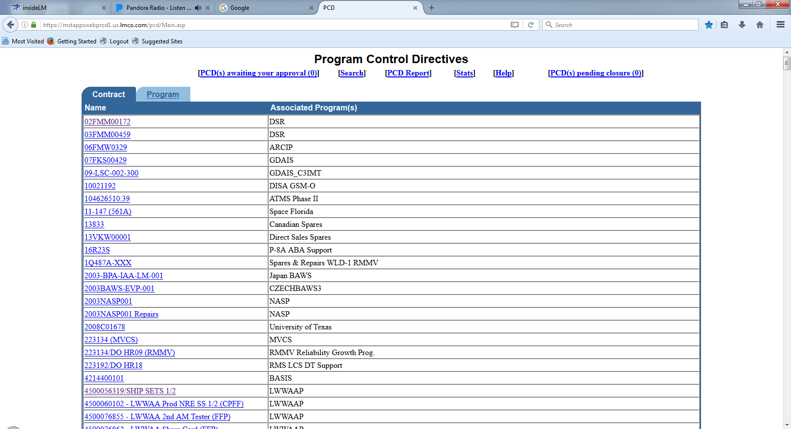
PCD Contract/Program List

Slide 27
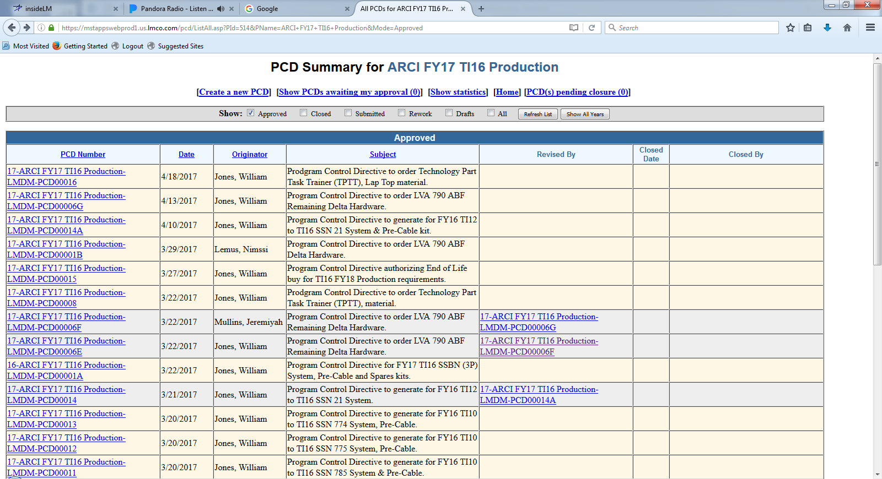
PCD Summary

Slide 28
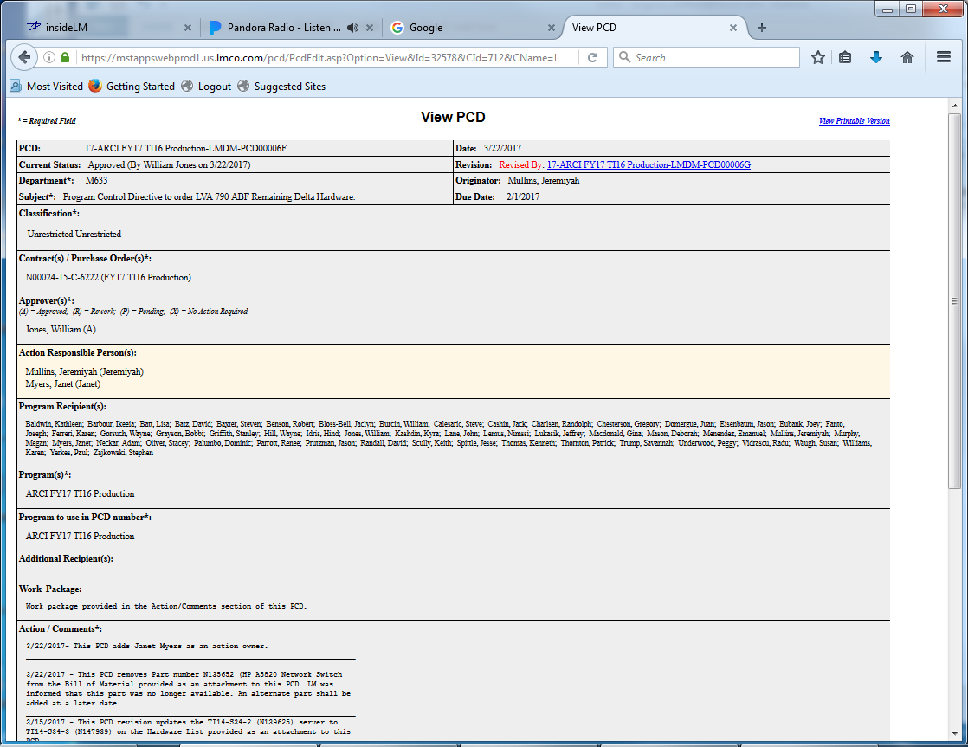
View PCD
Forward…
Cancel
Copy to another PCD

Slide 29
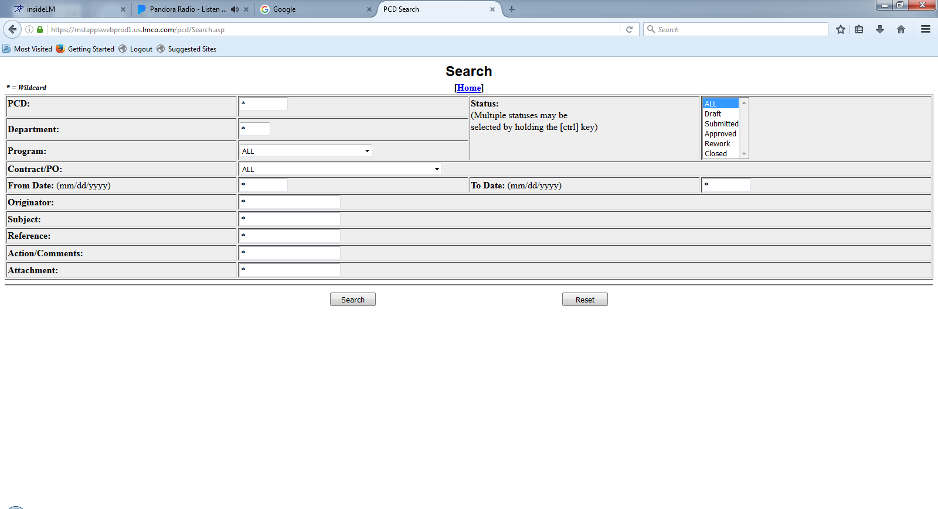
PCD Search

Slide 30
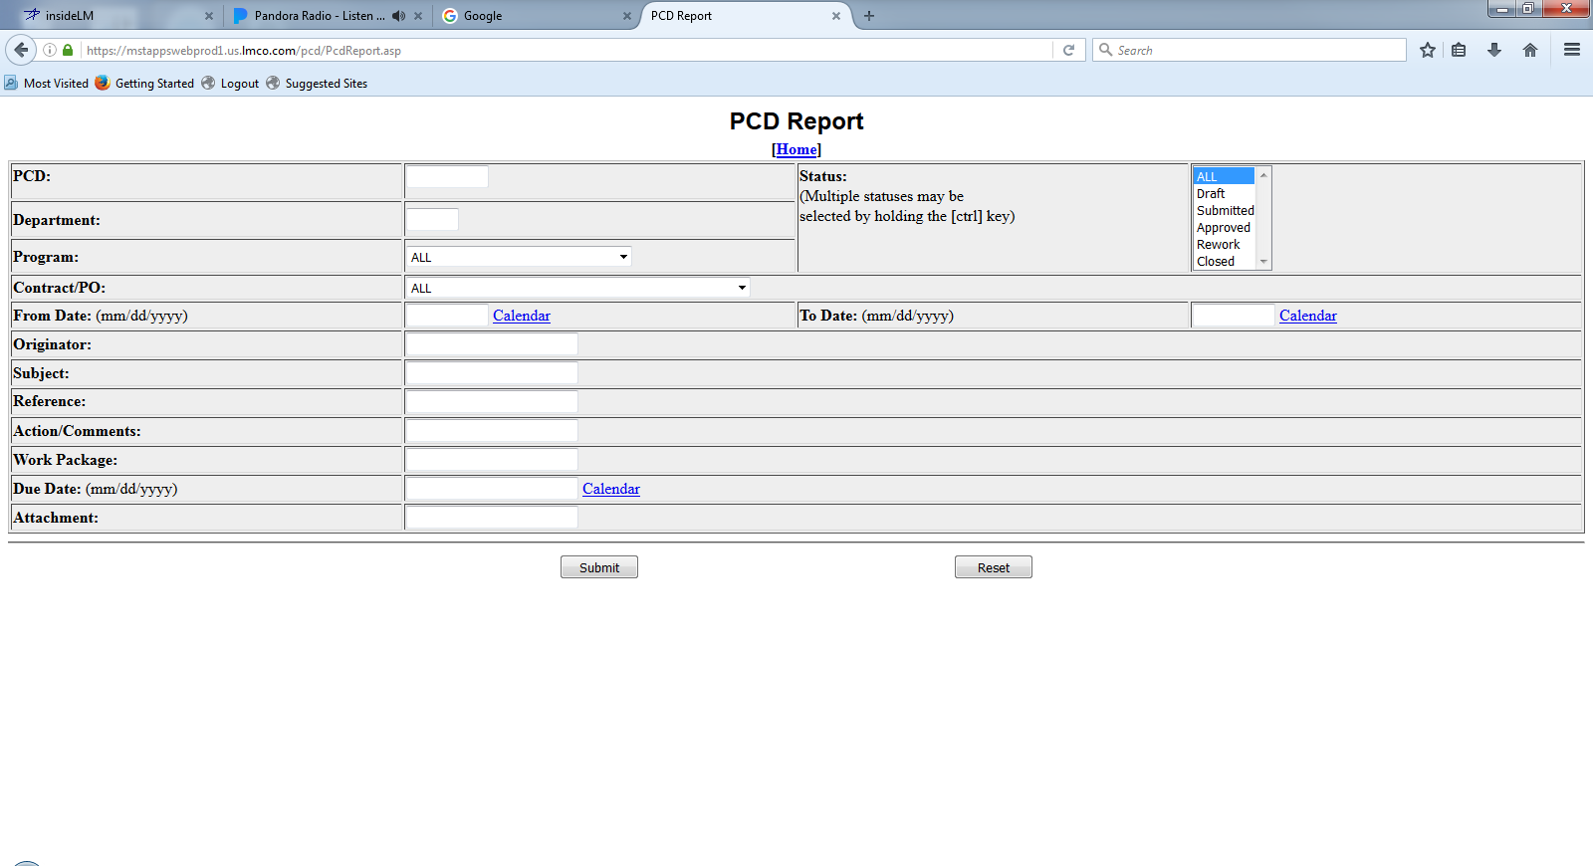
PCD Report

Slide 31
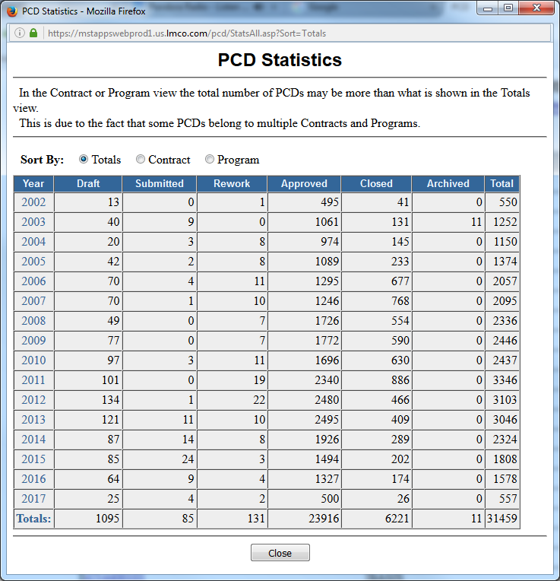
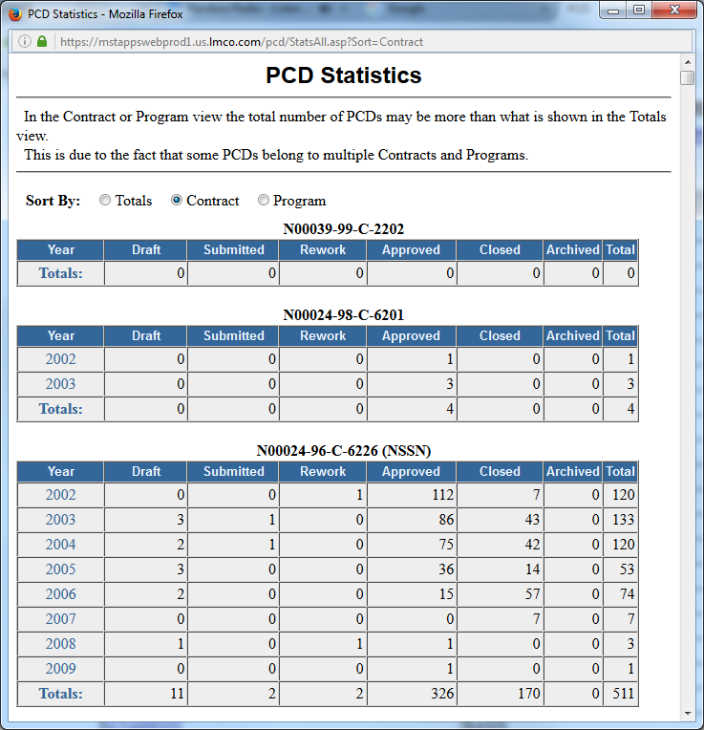
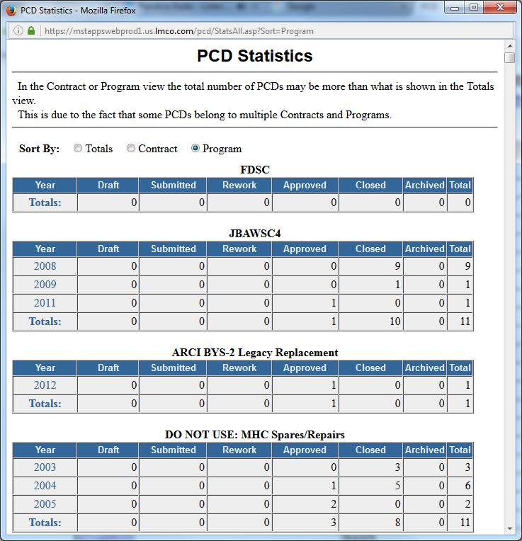
PCD Statistics

Slide 32
PCD Auxiliary Functions

Slide 33
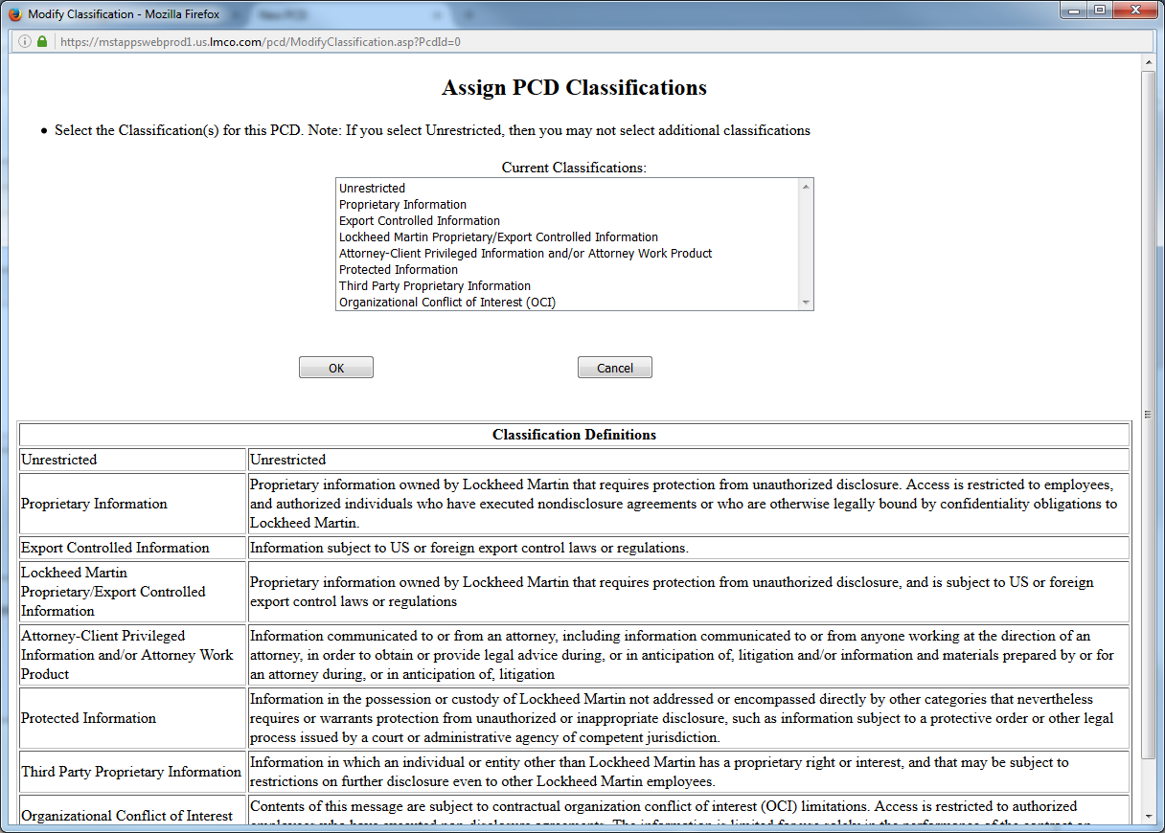
Classification

Slide 34
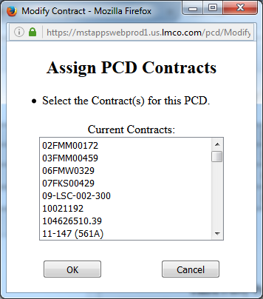
Contract(s) / Purchase Order(s)

Slide 35
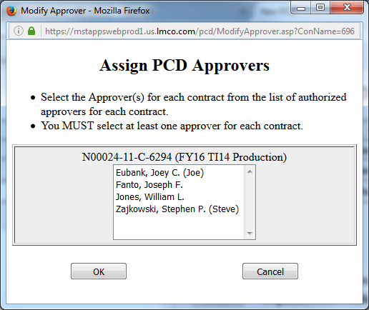
Assign Approver(s)

Slide 36
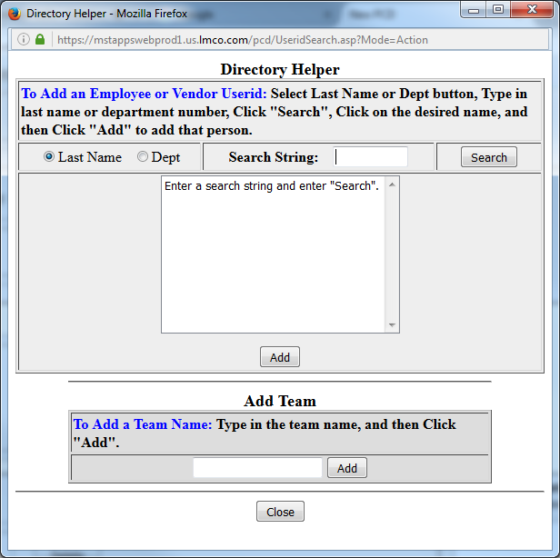
Action Responsible Person(s) / Additional Recipient(s)
Hardware List Entry

Slide 37
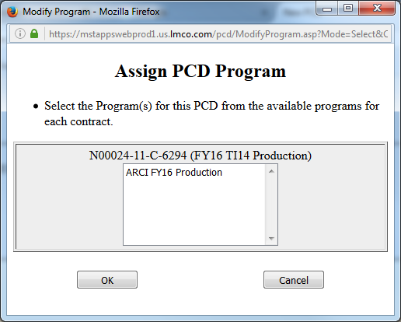
Assign Programs

Slide 38
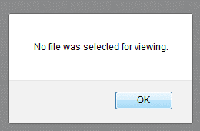
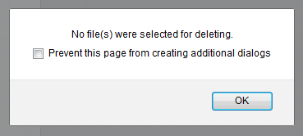
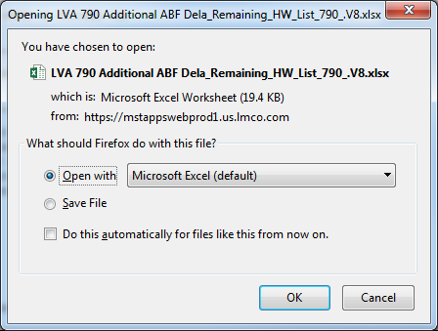
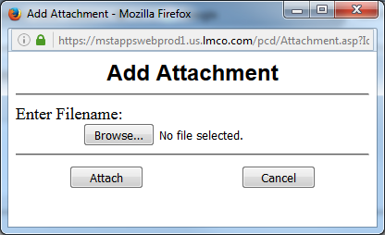
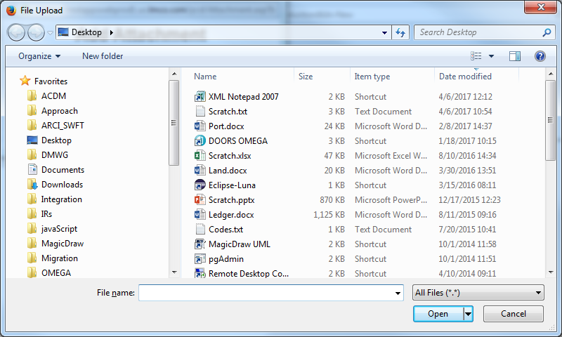
Attachments
Hardware List Entry
Task Review/Approve

Slide 39
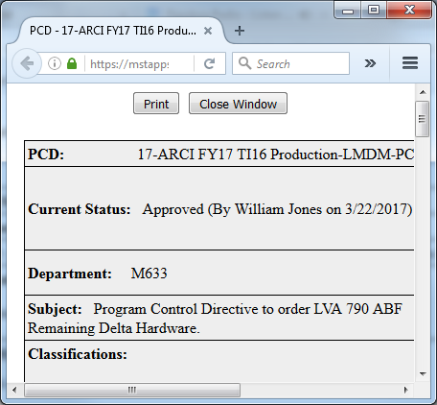
View Printable Version

Slide 40
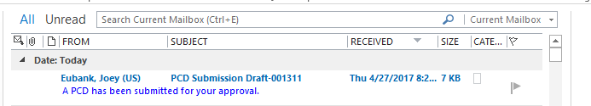
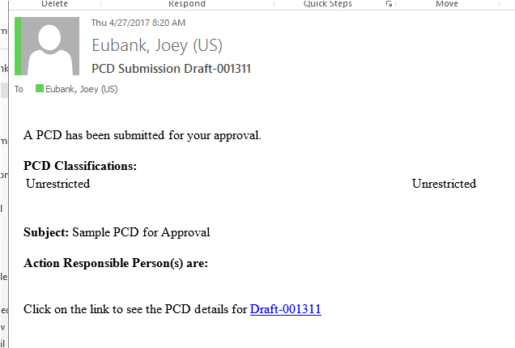
PCD Notification
The link takes you to the draft PCD.

Slide 41
PCD Notification
The link takes you to the draft PCD.

Slide 42
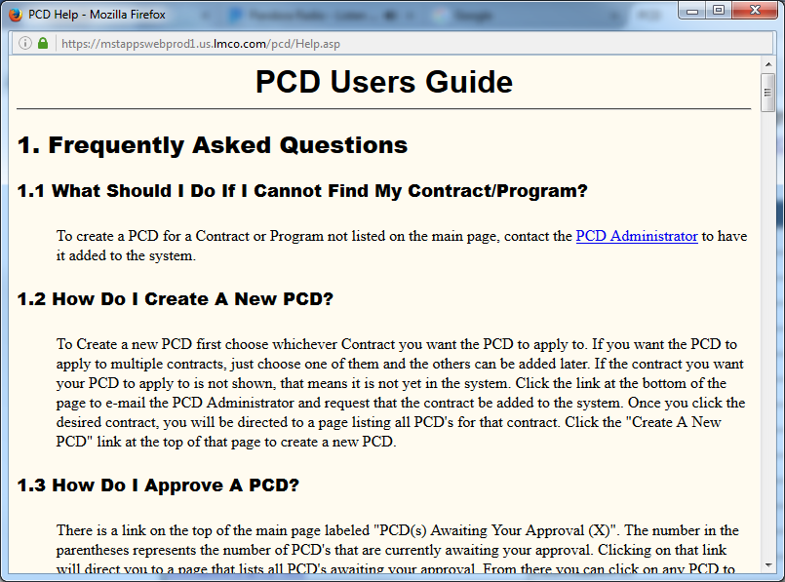
PCD Users Guide

